Slide 1
BT2102 Assignment 1
Group 2
Keltonn Lim Jing Feng
Reuben Ang Wen Zheng
Tham Shun Cong Aaron
Yu Shi Jie
Pui Yee Tong
Gan Hui Yan Angely

Slide 2
Customer, administrator
emailAddress
gender
phoneNumber
name
address
customerID
CUSTOMER
password
ADMINISTRATOR
adminID
phoneNumber
name
password
gender

Slide 3
Item, Product
powerSupply
productionYear
factory
model
color
serviceStatus
itemID
ITEM
PRODUCT
warranty
productID
cost
category
price
model

Slide 4
Purchase, Payment
purchaseID
purchaseDate
PURCHASE
requestStatus
requestDate
requestFee
REQUEST
requestID

Slide 5
Payment
PAYMENT
paymentDate
paymentAmount

Slide 6
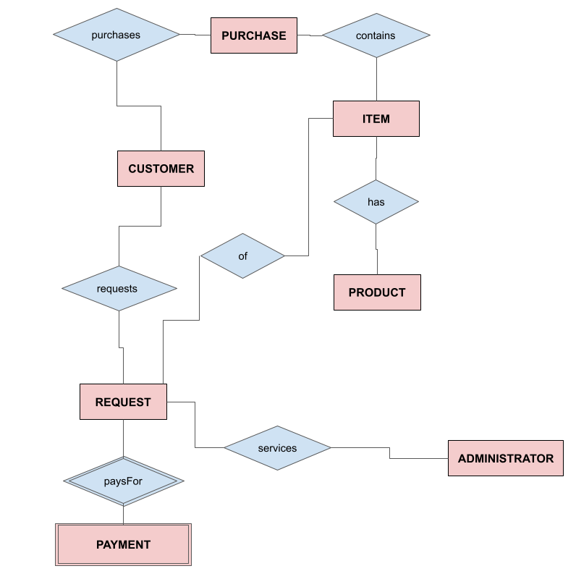
Identify relationships

Slide 7

Determine Cardinality

Slide 8
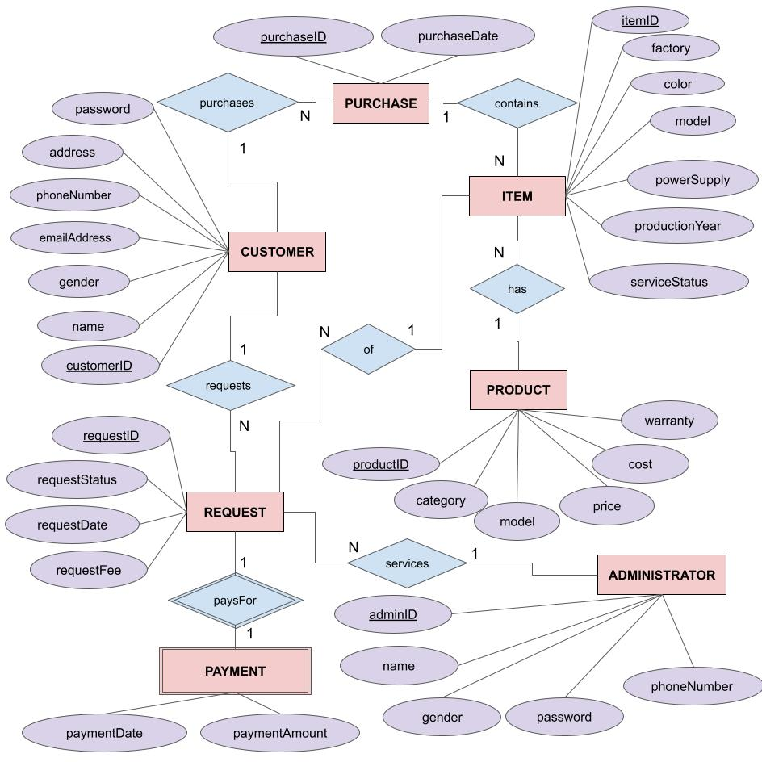
Conceptual Data Model

Slide 9
Refine Relational Schema
RELATIONS FROM ENTITIES
Strong entities
Product (productID, category, model, price, cost, warranty)
Item (itemID, color, powerSupply, productionYear, factory, serviceStatus, model)
Purchase (purchaseID, purchaseDate)
Customer (customerID, name, gender, emailAddress, phoneNumber, address, password)
Administrator (adminID, name, gender, phoneNumber, password)
Request (requestID, requestFee, requestDate, requestStatus)
Weak entities
Payment (requestID, paymentDate, paymentAmount)
RELATIONS FROM RELATIONSHIPS
Has (itemID, productID)
Services (requestID, adminID)
Requests (requestID, customerID)
Purchases (customerID, purchaseID)
Contains (itemID, purchaseID)
PaysFor (requestID) (weak reln)
Of (itemID, requestID)

Slide 10
Product - Has - Item (1:N)
Product (productID, category, model, price, cost, warranty)
Has (itemID, productID)
Item (itemID, color, powerSupply, productionYear, factory, serviceStatus, model)
Product (productID, category, model, price, cost, warranty)
Item (itemID, color, powerSupply, productionYear, factory, serviceStatus, model, productID)
Product (productID, category, model, price, cost, warranty)
Item (itemID, color, powerSupply, productionYear, factory, serviceStatus, model, productID)
Purchase (purchaseID, purchaseDate)
Customer (customerID, name, gender, emailAddress, phoneNumber, address, password)
Administrator (adminID, name, gender, phoneNumber, password)
Request (requestID, requestFee, requestDate, requestStatus)
Has (itemID, productID)
Services (requestID, adminID)
Requests (requestID, customerID)
Purchases (customerID, purchaseID)
Contains (itemID, purchaseID)
PaysFor (requestID) (weak reln)
Of (itemID, requestID)

Slide 11
Administrator - Services - Request (1:N)
Administrator (adminID, name, gender, phoneNumber, password)
Services (requestID, adminID)
Request (requestID, requestFee, requestDate, requestStatus)
Administrator (adminID, name, gender, phoneNumber, password)
Request (requestID, requestFee, requestDate, requestStatus, adminID)
Product (productID, category, model, price, cost, warranty)
Item (itemID, color, powerSupply, productionYear, factory, serviceStatus, model, productID)
Purchase (purchaseID, purchaseDate)
Customer (customerID, name, gender, emailAddress, phoneNumber, address, password)
Administrator (adminID, name, gender, phoneNumber, password)
Request (requestID, requestFee, requestDate, requestStatus, adminID)
Has (itemID, productID)
Services (requestID, adminID)
Requests (requestID, customerID)
Purchases (customerID, purchaseID)
Contains (itemID, purchaseID)
PaysFor (requestID) (weak reln)
Of (itemID, requestID)

Slide 12
Customer - Requests - Request (1:N)
Customer (customerID, name, gender, emailAddress, phoneNumber, address, password)
Requests (requestID, customerID)
Request (requestID, requestFee, requestDate, requestStatus, adminID)
Customer (customerID, name, gender, emailAddress, phoneNumber, address, password)
Request (requestID, requestFee, requestDate, requestStatus, adminID, customerID)
Product (productID, category, model, price, cost, warranty)
Item (itemID, color, powerSupply, productionYear, factory, serviceStatus, model, productID)
Purchase (purchaseID, purchaseDate)
Customer (customerID, name, gender, emailAddress, phoneNumber, address, password)
Administrator (adminID, name, gender, phoneNumber, password)
Request (requestID, requestFee, requestDate, requestStatus, adminID, customerID)
Has (itemID, productID)
Services (requestID, adminID)
Requests (requestID, customerID)
Purchases (customerID, purchaseID)
Contains (itemID, purchaseID)
PaysFor (requestID) (weak reln)
Of (itemID, requestID)

Slide 13
Purchase - Contains - Item (1:N)
Purchase (purchaseID, purchaseDate)
Contains (itemID, purchaseID)
Item (itemID, color, powerSupply, productionYear, factory, serviceStatus, model, productID)
Purchase (purchaseID, purchaseDate)
Item (itemID, color, powerSupply, productionYear, factory, , serviceStatus, model, purchaseID, productID)
Product (productID, category, model, price, cost, warranty)
Item (itemID, color, powerSupply, productionYear, factory, serviceStatus, model, purchaseID, productID)
Purchase (purchaseID, purchaseDate)
Customer (customerID, name, gender, emailAddress, phoneNumber, address, password)
Administrator (adminID, name, gender, phoneNumber, password)
Request (requestID, requestFee, requestDate, requestStatus, adminID, customerID)
Has (itemID, productID)
Services (requestID, adminID)
Requests (requestID, customerID)
Purchases (customerID, purchaseID)
Contains (itemID, purchaseID)
PaysFor (requestID) (weak reln)
Of (itemID, requestID)

Slide 14
Customer - Purchases - Purchase (1:N)
Customer (customerID, name, gender, emailAddress, phoneNumber, address, password)
Purchases (customerID, purchaseID)
Purchase (purchaseID, purchaseDate)
Customer (customerID, name, gender, emailAddress, phoneNumber, address, password)
Purchase (purchaseID, purchaseDate, customerID)
Product (productID, category, model, price, cost, warranty)
Item (itemID, color, powerSupply, productionYear, factory, , serviceStatus, model, purchaseID, productID)
Purchase (purchaseID, purchaseDate, customerID)
Customer (customerID, name, gender, emailAddress, phoneNumber, address, password)
Administrator (adminID, name, gender, phoneNumber, password)
Request (requestID, requestFee, requestDate, requestStatus, adminID, customerID)
Has (itemID, productID)
Services (requestID, adminID)
Requests (requestID, customerID)
Purchases (customerID, purchaseID)
Contains (itemID, purchaseID)
PaysFor (requestID) (weak reln)
Of (itemID, requestID)

Slide 15
Payment - PaysFor - Request (1:1)
Payment (requestID, paymentDate, paymentAmount)
PaysFor (requestID)
Request (requestID, requestFee, requestDate, requestStatus, adminID, customerID)
Payment (requestID, paymentDate, paymentAmount)
Request (requestID, requestFee, requestDate, requestStatus, adminID, customerID)
Product (productID, category, model, price, cost, warranty)
Item (itemID, color, powerSupply, productionYear, factory, serviceStatus, model, purchaseID, productID)
Purchase (purchaseID, purchaseDate, customerID)
Customer (customerID, name, gender, emailAddress, phoneNumber, address, password)
Administrator (adminID, name, gender, phoneNumber, password)
Request (requestID, requestFee, requestDate, requestStatus, adminID, customerID)
Has (itemID, productID)
Services (requestID, adminID)
Requests (requestID, customerID)
Purchases (customerID, purchaseID)
Contains (itemID, purchaseID)
PaysFor (requestID) (weak reln)
Of (itemID, requestID)

Slide 16
Request - Of - Item (1:1)
Request (requestID, requestFee, requestDate, requestStatus, adminID, customerID)
Of (itemID, requestID)
Item (itemID, color, powerSupply, productionYear, factory, serviceStatus, model, purchaseID, productID)
Request (requestID, requestFee, requestDate, requestStatus, adminID, customerID, itemID)
Item (itemID, color, powerSupply, productionYear, factory, serviceStatus, model, purchaseID, productID)
Product (productID, category, model, price, cost, warranty)
Item (itemID, color, powerSupply, productionYear, factory, serviceStatus, model, purchaseID, productID)
Purchase (purchaseID, purchaseDate, customerID)
Customer (customerID, name, gender, emailAddress, phoneNumber, address, password)
Administrator (adminID, name, gender, phoneNumber, password)
Request (requestID, requestFee, requestDate, requestStatus, adminID, customerID, itemID)
Has (itemID, productID)
Services (requestID, adminID)
Requests (requestID, customerID)
Purchases (customerID, purchaseID)
Contains (itemID, purchaseID)
PaysFor (requestID) (weak reln)
Of (itemID, requestID)

Slide 17
The Final Schema
Customer (customerID, name, gender, emailAddress, phoneNumber, address, password)
Administrator (adminID, name, gender, phoneNumber, password)
Product (productID, category, model,cost, price, warranty)
Item (itemID, color, factory, powerSupply, productionYear, model, serviceStatus, productID, purchaseID)
Purchase (purchaseID, purchaseDate, customerID)
Request (requestID, requestFee, requestDate, requestStatus, customerID, adminID, itemID)
Payment (requestID, paymentDate, paymentAmount)

Slide 18
Logical Data Model
Customer (customerID, name, gender, emailAddress, phoneNumber, address, password) Primary Key customerID | Administrator (adminID, name, gender, phoneNumber, password) Primary Key adminID
Product (productID, category, model,cost, price, warranty) Primary Key productID | Item (itemID, color, factory, powerSupply, productionYear, model, serviceStatus, productID, purchaseID) Primary Key itemID Foreign Key productID references Product(productID) Foreign Key purchaseID references Purchase(purchaseID)
Purchase (purchaseID, purchaseDate, customerID) Primary Key productID Foreign Key customerID references Customer(customerID) | Request (requestID, requestFee, requestDate, requestStatus, customerID, adminID, itemID) Primary Key requestID Foreign Key customerID references Customer(customerID) Foreign Key adminID references Administrator(adminID) Foreign Key itemID references Item(itemID)
Payment (requestID, paymentDate, paymentAmount) Primary Key requestID

